Slide 1
Unit 7: Sorting BY : S. R. Sharma
Preliminaries of sorting, bubble sort, insertion sort
lower bound for simple sorting algorithm
Shell sort, heap sort, merge sort, quick sort,
Bucket sort,
Notes:
We designed this template so that each member of the project team has a set of slides with its own theme. Members, here’s how you add a new slide to just your set:
Mark where you want to add the slide: Select an existing one in the Thumbnails pane, click the New Slide button, then choose a layout. The new slide gets the same theme as the other slides in your set.
Careful! Don’t annoy your fellow presenters by accidentally changing their themes. That can happen if you choose a different theme from the Design tab, which changes all of the slides in the presentation to that look.

Slide 2
Preliminaries of sorting
The algorithm we describes will be interchangeable.
Each will be passed an array containing the elements and an integer containing the number of elements.
We will assume that existence of the “<“ and ”>” operators for the comparisons.
Sorting under these condition is known as comparisons-based sorting.

Slide 3
Insertion sort
The insertion sort insert each elements in proper place. If there are N elements in the array and we place each element of array at proper place in previously sorted element list.
let us take there are N elements in the arr. The process of inserting each elements in proper place is as;
Pass1: arr[0] is already sorted because only one element.
Pass 2: arr[1] is inserted before or after arr[0].
so that arr[0] and arr[1] are sorted.

Slide 4
Cont……
Pass 3: arr[2] is inserted before arr[0], in between arr[0] and arr[1], or after arr[1].
so that arr[0],arr[1] and arr[2] are sorted
………………………………………………………………
………………………………………………………………..
Pass N-1: arr[N-1] is inserted into its proper place in array arr[0] ,arr[1], arr[2] ………..arr[N-2]
So arr[0],arr[1], arr[2] ……..arr[N-1] are sorted.

Slide 5
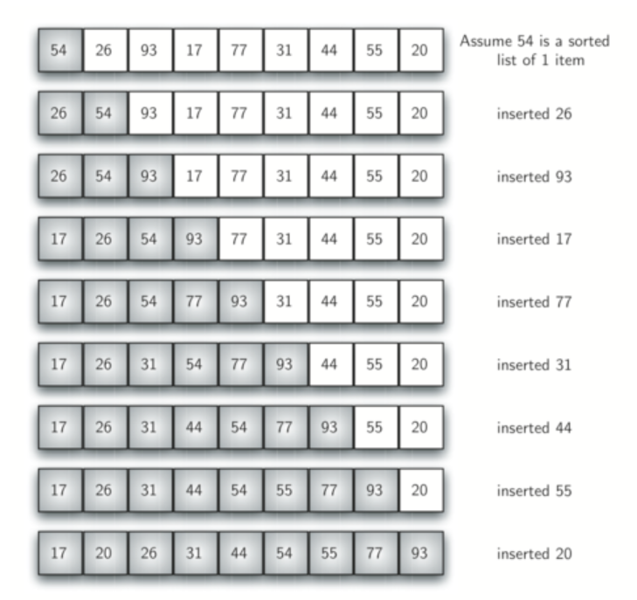

Slide 6
Analysis of insertion sort
The first elements has no other elements before it. So it does not required any comparison . Second element requires 1 comparison ,third requires 2 comparisons and so on . Therefore total number of comparisons will be:-
1+2+3……………+(N-2)+(N-1)
it’s a form of arithmetic progression so we can apply formula :

Slide 7
Cont..
Sum = N/2[2a+(n-1)d]
=(n-1)/2[2*1+(n-1-1)*1]
=(n-1)/2[2+n-2]
= n(n-1)/2 which is of o(n²).
it’s worse case of behavior of insertion sort where all elements are in reverse order.
Insertion sort behaves as of o(n) when elements are in sorted order and also has worth when list of elements are near about sorted.

Slide 8
Bubble sort
If N elements are given in memory then for sorting, we will do following steps:-
1. first compare first and second element of array if 1st <2nd then
compare the 2nd with 3rd
2. if 2nd > 3rd then interchange the value of 2nd and 3rd
3. now we compare the value of 3rd with 4th
4. similarly compare until the N-1th element is compared with N th
element
5. now the highest value element is reached at the Nth place.
6. now elements will be compared until N-1 elements

Slide 9
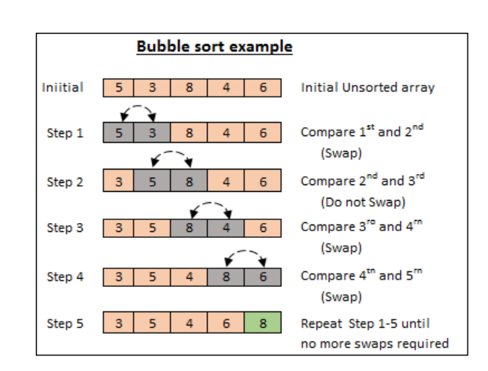

Slide 10
Analysis of bubble sort.
In bubble sort n-1 )comparison will be in 1st pass, n-2 in 2nd pass,n-3 in 3rd pass and so on.it is very simple to calculate the number of comparison. Total number of comparison wiil be
(n-1)+(n-2)+(n-3)+…….+3+2+1. it’s a form of arithmetic progession , so we can apply formula
Sum=n/2[2a+(n-1)d] => (n-1)/2[2*1(n-1-1)*1]
=(n-1)/2[2+n-2]
=n(n-1)/2 which is of O(n²).

Slide 11
Cont..
The main advantages of bubble sort is simplicity of algorithm, additional space requirement is only one temporary variable and it behaves as 0(n) for sorted array of element.

Slide 12
Selection sort
The process of sorting elements using selection sort is as
Pass 1: a. searach the smallest elements from arr[0] ……arr[n-1].
b. interchange arr[0] with the smallest element.
Result: arr[0] is sorted
Pass 2: a. searach the smallest elements from arr[1] ……arr[n-1]
b. interchange arr[1] with the smallest elements
Result : arr[0], arr[1] is sorted.
Pass N-1: a. search smallest elements from arr[n-2] and arr[n-1]
b. interchange arr(n-2) with smallest
Result : arr[0] ……………arr[n-1] is sorted.

Slide 13
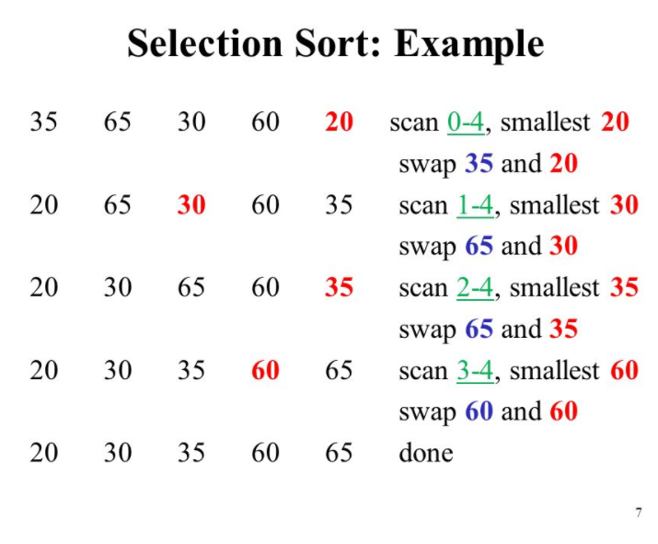

Slide 14
Analysis of selection sort
In selection sort pass one will compare n-1 elements pass 2 will compare n-2 elements and so on pass n-2 will compare only 1 elements so , total number of elements comparison is given by
sum=(n-1)+(n-2)+(n-3)+…………..3+2+1
it is arithmetic series in decreasing oreder so apply formula
Sum = n/2[2a+(n-1)d]
= (n-1)/2[2(n-1)+{(n-1)-1}{(n-2)-(n-1)}]
=(n-1)/2[2n-2+(n-1-1)(n-2-n+1)]
=(n-1)/2[2n-2-n+2)
=n(n-1)/2
=0(n²) its has same behavior in both worst case and best case.

Slide 15
Shell Sort
D.L.Shell proposed an improvement on insertion sort in 1959 named after him as shell sort. In insertion sort items can be moved only at one position because it compares with only adjacent items. If we take the items at particular distance (increments) then we can compare items which are far apart ane we can sort them.

Slide 16
Cont..
Let us take an array from arr[0] ……….arr[N-1] and we take the distance (increments) 5 and then 3 and at last with 1.
arr[0], arr[1], arr[2], arr[3], arr[4], arr[5], arr[6], arr[7], arr[8] ,arr[9], arr[10], arr[11],
Pass 1:sort between arr[0], arr[5],arr[10] as same as arr[1],arr[6],arr[11] with differenet of 5
Pass 2: take the different of 3.
Pass 3: take the different of 1.

Slide 17
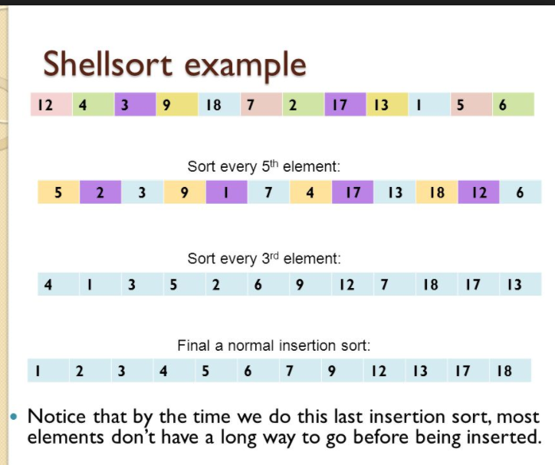

Slide 18
Analysis of shell sort.
As we know shell sort is an improvement on insertion sort. insertion sort is very efficient when number of elements are less. The number of comparison is not more than two position, so it’s a best case of insertion sort.

Slide 19
Merge sort.
In merge sort at first divide the data into individual elements this process is known as divide. After dividing the date into individual data element we will combine the data into
arr[0]+arr[1] arr[2]+arr[3] and so on
Again combine until it become a single array list as following.

Slide 20
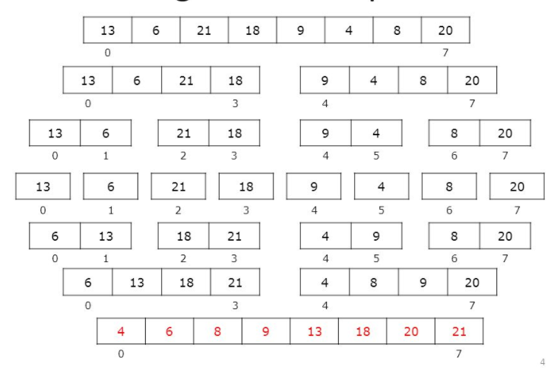

Slide 21
Analysis of merge sort
Let us take an array of size n is used for merge sort. Because here we take elements in pair and merge with another pair after sorting. So merge sort required maximum log₂n passes.
Each pass, total number of comparison can be maximum n, so the we can say that merge sort required maximum n*log₂ n comparisons which is of o(nlog2n). The disadvantage of merge sort is it required extra space of o(n)

Slide 22
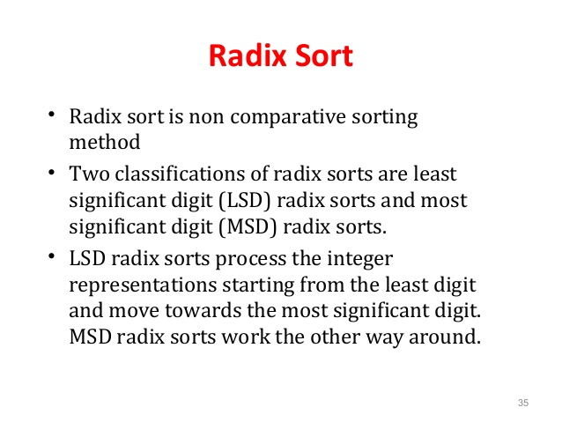
Radix sort or bucket sort.

Slide 23
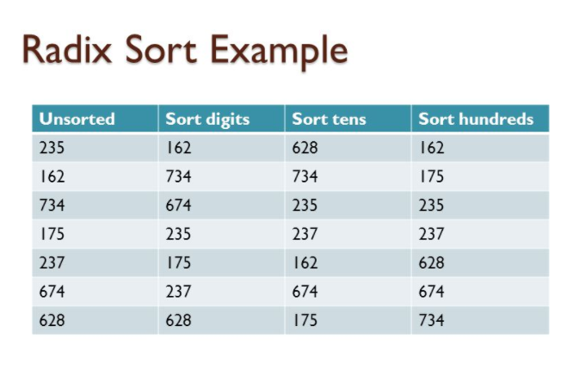

Slide 24
Analysis of radix sort
Radix sort dependent on three things
Radix (10 for decimal, 26 for alphabets and 2 for binary
Number of digits in largest elements
Size of array of elements
number of passed is the number of digits in largest elements i.e. p. in each pass we will compare the digits of elements i.e. maximum value of radix r. so the maximum number of comparison will be
p*r*n.

Slide 25
Cont..
Worst case: suppose the number of digits in largest elements is equal to number of elements in array then maximum number of comparisons = p*n*n
Best case: in best case the number of digit in largest elements will be log_{p}n. So maximum number of comparisons =p*(log_{p}n)*n
The disavantage of radix sort is extra space is required. Suppose for particular pass all the elements are in same index then it will be in need of space p*n.

Slide 26
Quick sort
In quick sort we divide the original list into two sublist. We choose the item from list called the key or pivot from which all left side of elements are smaller and all the right side of elements are greater than that elements. So we can create two lists, one list on the left side and other on right side of pivot, means pivot will be in its actual position. Hence there are two conditions for choosing pivot:-

Slide 27
Cont..
All the elements on the left side of pivot should be smaller then pivot
All the elements on the right side of pivot should be greater than or equal to pivot.
Similarly we choose the pivot for dividing the sub lists until there are 2 or more elements in sub list

Slide 28
The process for sorting the elements through quick sort is as:
Take the first elements of list as pivot.
Place pivot at the proper place in list. So one elements of the list i.e. pivot will be at it’s proper place.
Create two sub lists left and right side of pivot
Repeat the same process until all elements of list are at proper position in list.

Slide 29
Let us take a list of elements and process through quick sorting
29 8 59 72 88 42 65 95 19 82
Here we are taking 48 as pivot and we have to start comparison from right to left
Now the first element less than 48 is 19. so interchange it pivot i.e.48.
29 8 59 72 88 42 65 95 48 82
Now comparison will start from 19 and will be from left to right. The first element greater than 48 is 59. so interchange it with pivot
29 8 48 72 88 42 65 95 59 82

Slide 30
Now comparison will start from 59 and will be from right to left. The first elements less than 48 is 42. so interchange it will pivot
29 8 42 72 88 48 65 95 59 82
Now the comparison will start from 42 will be left to right.
29 8 42 48 88 72 65 95 59 82
Now the comparison will start from 72 and be from right to left. There is no element less than 48. so 48 is its proper position in the list. So it divide the list into two left and right side of pivot
19 29 8 42 48 88 72 65 95 59 82

Slide 31
Then again same process will repeat on both left sub list and right sub list at last all data will be in sorted order as
19 29 42 48 59 65 72 82 88 95

Slide 32
Analysis of quick sort
Time requirement of quick sort depends on the position of pivot in the list, how pivot is dividing list into sub lists. It may be equal division of list or may be it will not divide also.
Average case:- we assume that list is equally divided into two half for each time by chosen pivot so total number of elements at particular level will be log₂n.
The number of comparison at any level will be maximum n. so we can say run time of quick sort will be of
O(n log n)

Slide 33
Worst case:-
Suppose list of elements are already in sorted order. When we find the pivot then it will be first element. So here it produces only 1 sub list which is on right side of first elenemnts start from second elements and so on..
So total number of comparison will be:-
n+(n-1)+(n-2)+……..+3+2+1
It’s a form of arithmetic series, so we can use formula
sum=n/2[2a+(n-1)*d]
=n/2[2*1+(n-1)*1]
Which is in the form of o(n₂)

Slide 34
Basic External Sorting Algorithm
Assume unsorted data is on disk at start
Let M = maximum number of records that can be stored & sorted in internal memory at one time
Algorithm
Repeat:
Read M records into main memory & sort internally.
Write this sorted sub-list onto disk. (This is one “run”).
Until all data is processed into runs
Repeat:
Merge two runs into one sorted run twice as long
Write this single run back onto disk
Until all runs processed into runs twice as long
Merge runs again as often as needed until only one large run: the sorted list

Slide 35
Basic External Sorting
81
94
11
96
12
35
17
99
28
58
41
75
15
Unsorted Data on Disk
Assume M = 3 (M would actually be much larger, of course.) First step is to read 3 data items at a time into main memory, sort them and write them back to disk as runs of length 3.
11
81
94
17
28
99
15
12
35
96
41
58
75

Slide 36
Basic External Sorting
11
81
94
17
28
99
15
12
35
96
41
58
75
Next step is to merge the runs of length 3 into runs of length 6.
11
12
35
81
94
96
17
28
41
58
75
99
15

Slide 37
Basic External Sorting
11
12
35
81
94
96
15
17
28
41
58
75
99
Next step is to merge the runs of length 6 into runs of length 12.
11
12
17
28
35
41
58
75
81
94
96
99
15

Slide 38
Basic External Sorting
11
12
17
28
35
41
58
75
81
94
96
99
15
Next step is to merge the runs of length 12 into runs of length 24. Here we have less than 24, so we’re finished.
11
12
15
17
28
35
41
58
75
81
94
96
99

